Slide 1


TRACKING INTERNET SALES USING ADVENTURE WORKS
Data warehouse implementation
Final Project
Submitted By’
Basavraj Jaliminche (8800149)
RAGHUVEER Reddy (8801135)
Nachiket Solanki (8799955)
Rohit Arora

Slide 2
Agenda:
Track the fields in Internet sales database using STAR schema dimension modeling.
In this project we are going to track fields like ,
1.UnitPrice
2.TotalProductCost
3.SalesAmount
4.TaxAmt
5.Freight

Slide 3
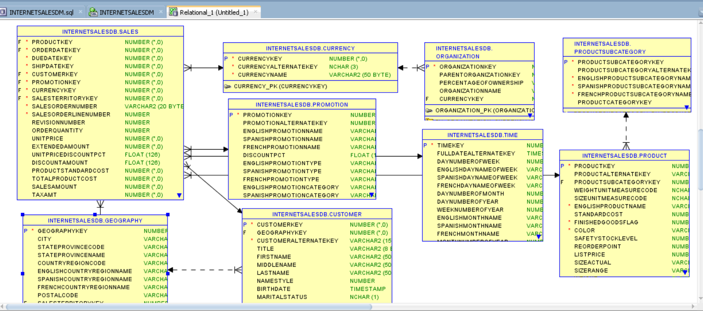
System Relational Model :

Slide 4
Internet Sales Datamart
Designing the STAR schema :
Star schema is the fundamental schema among the data mart schema and it is simplest. This schema is widely used to develop or build a data warehouse and dimensional data marts. It includes one or more fact tables indexing any number of dimensional tables. The star schema is a necessary cause of the snowflake schema. It is also efficient for handling basic queries.
Advantages of Star Schema :
Simpler Queries –
Simplified Business Reporting Logic –
Feeding Cubes –

Slide 6
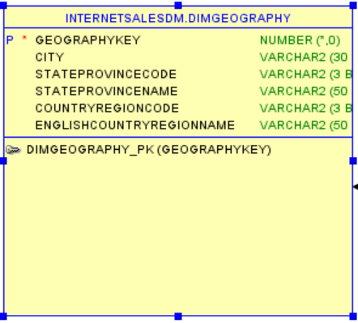
Selected 7 tables

Slide 7
OLAP : Oracle OLAP is a world class multidimensional analytic engine
Oracle OLAP makes it easy to produce analytic measures, including time-series calculations, financial models, forecasts, allocations, regressions, and more.
Hundreds of analytic functions can be easily combined in custom functions to solve nearly any analytic calculation requirement.
Oracle OLAP cubes are represented using a star schema design: dimension views form a constellation around the cube (or fact) view.
This standard representation of OLAP data makes it easy for any reporting and analysis tool or application - including sophisticated business intelligence solutions, SQL-based development tools and Microsoft Excel - to leverage the power of Oracle OLAP in a simple and productive way.

Slide 8
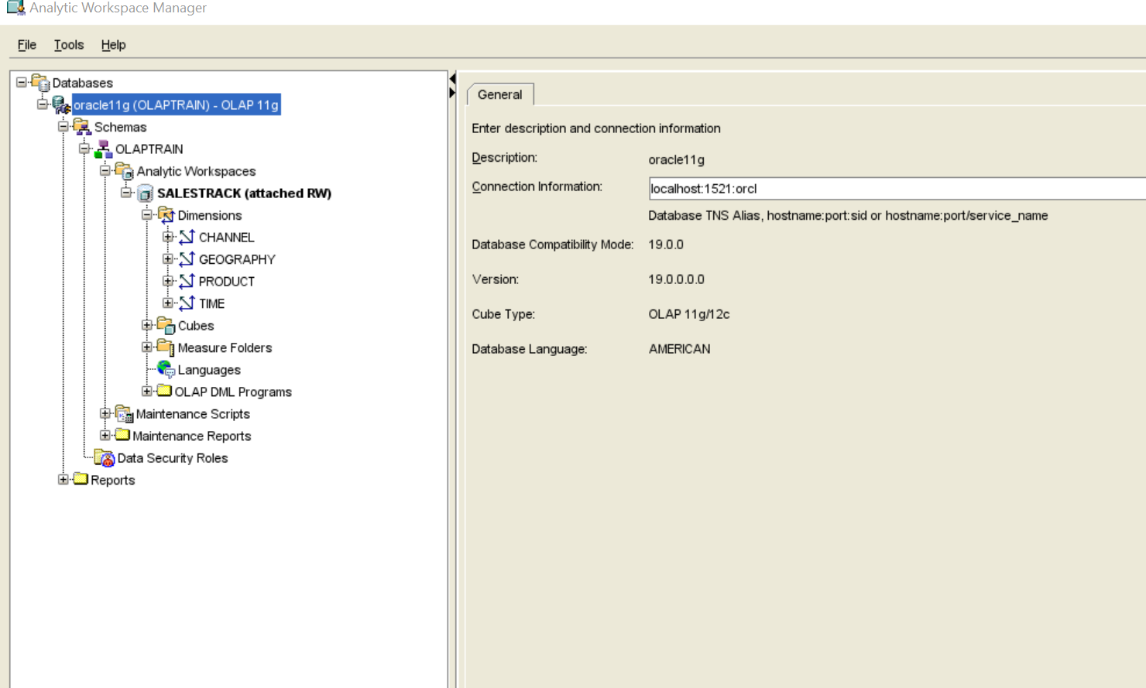
Steps done for OLAP
As mentioned in the document we have done steps

Slide 9
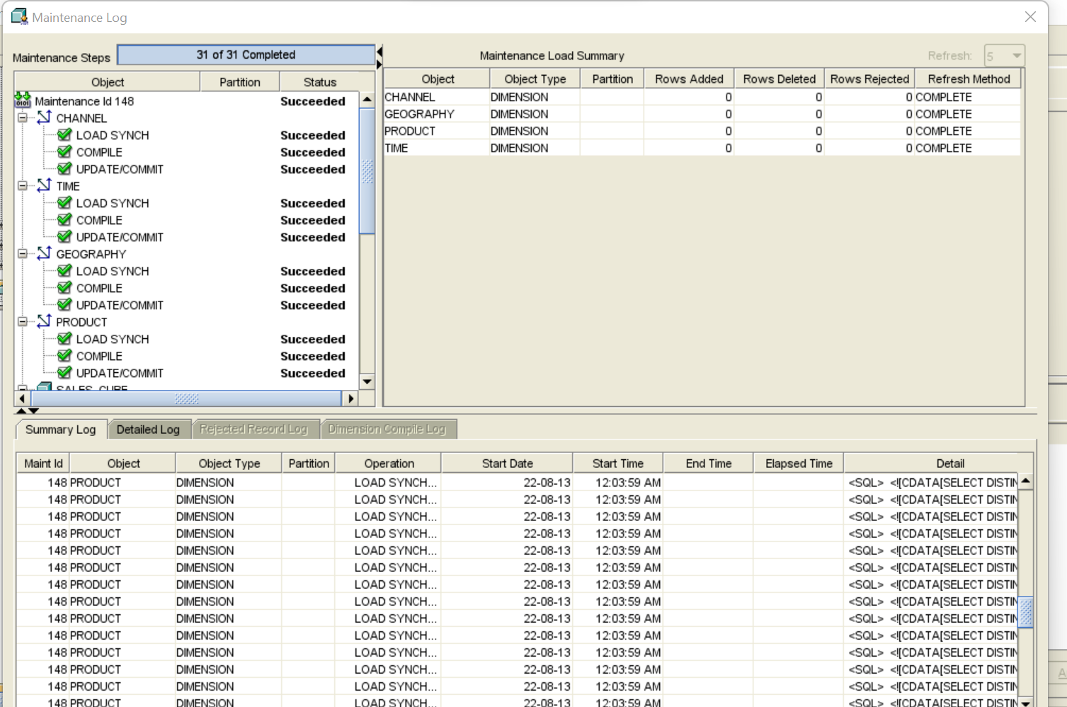
Maintenance Log

Slide 10
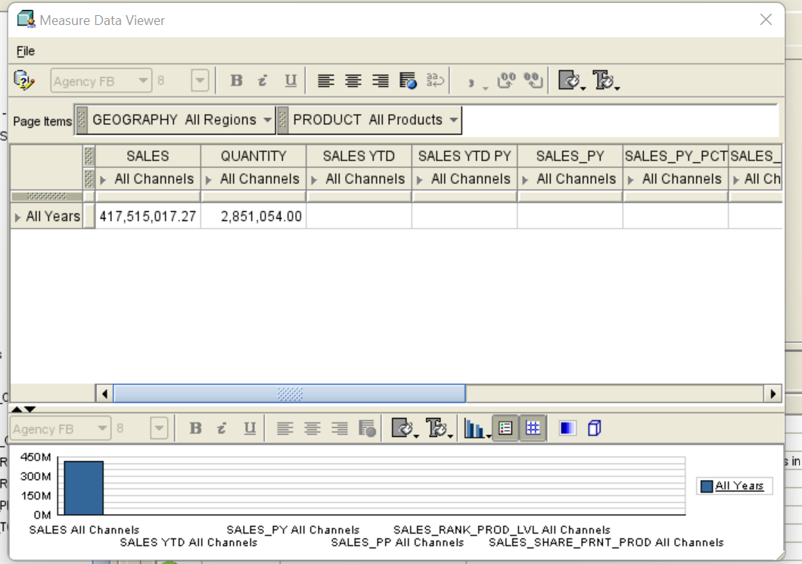
Data for all Years

Slide 11
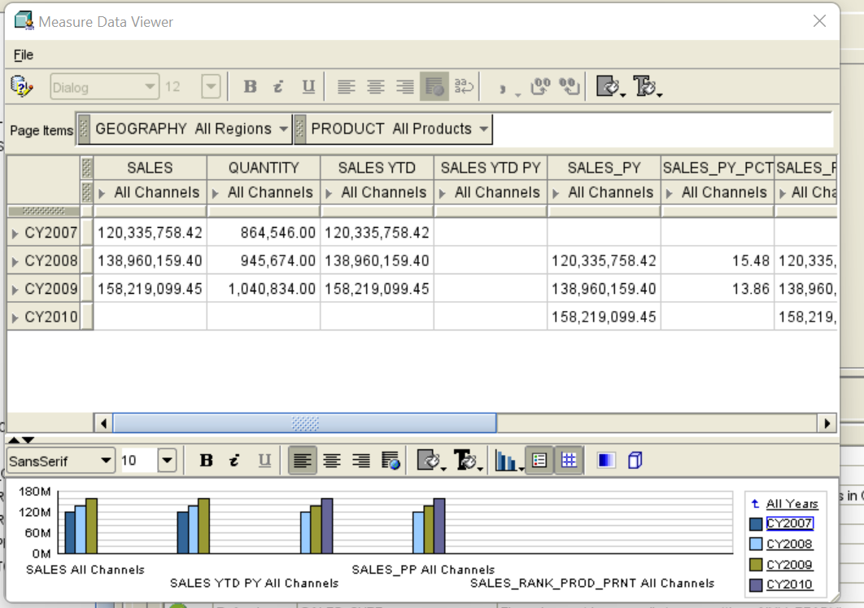
Data with Quatar sales :

Slide 12
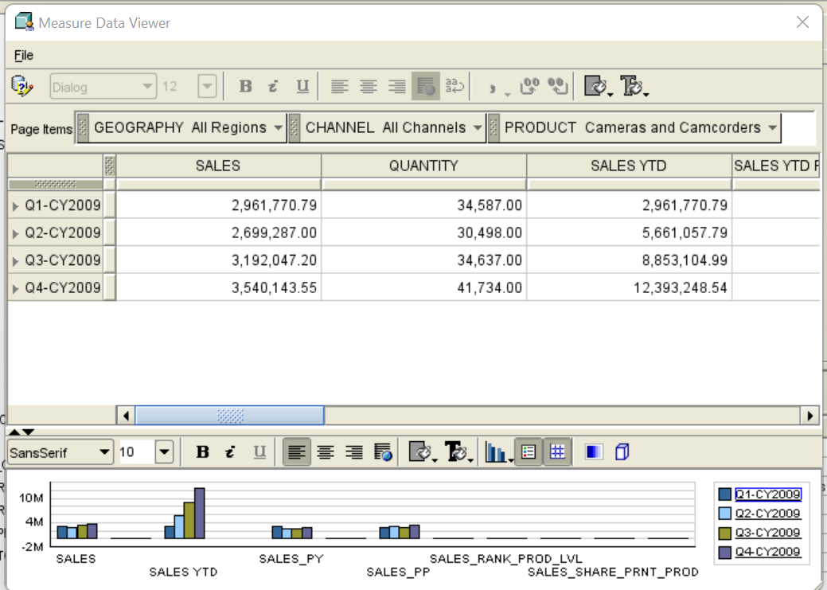

Slide 13
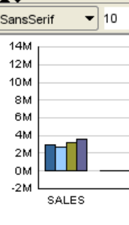
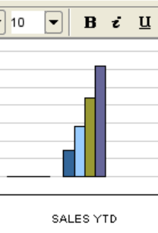
Sales data View :

Slide 14

Thank You!

